Slide 1
The Three States in Git
Git has three main states that your files can reside in: modified, staged, and committed:
Modified means that you have changed the file but have not committed it to your database yet.
Staged means that you have marked a modified file in its current version to go into your next commit snapshot.
Committed means that the data is safely stored in your local database.

Slide 2
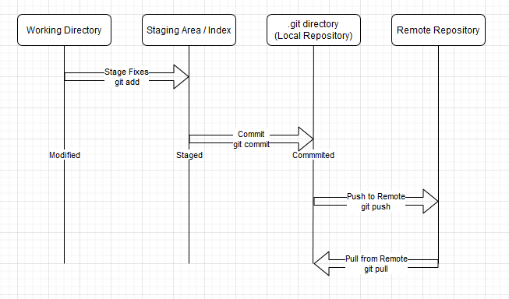
Git Workflow

